Slide 1
WELCOME
TO OUR PRESENTATION

Slide 2
ENGLISH READING SKILLS & PUBLIC SPEAKING

Slide 3
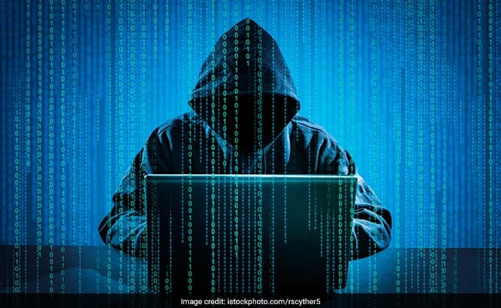
CYBER CRIME

Slide 4

In this presentation there are five part of cyber crime :
1. INTRODUCTION
2. TYPES OF CYBER CRIME :
3. HISTORY OF CYBER CRIME
4. CYBER CRIMINAL
5. PREVENT OF CYBER CRIME

Slide 5
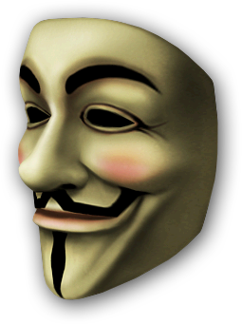
(i) What is cyber crime :
(ii) INFORMATION ON CYBER CRIME :
(iii) HOW CYBER CRIMINALS WORK :
(Coders,kids,Drops,Mobs)
(iv) TYPES OF CYBER HACKERS :
(White hat hacker, Black hat hackers, Grey Hat Hackers)

Slide 6

TIPS TO GET PROTECTED FROM CYBER CRIME:
(Terminate Online Session Completely,
Use Security ProgramsProtect
Protect Your Password
Use Your Own Computer
Participation in Social Networking
*THANK YOU ALL*

Slide 7
TYPES OF CYBER CRIME :
Three major part of cyber crime :
(i) Crime against person
(ii) Crime against property
(iii) Crime against government

Slide 8

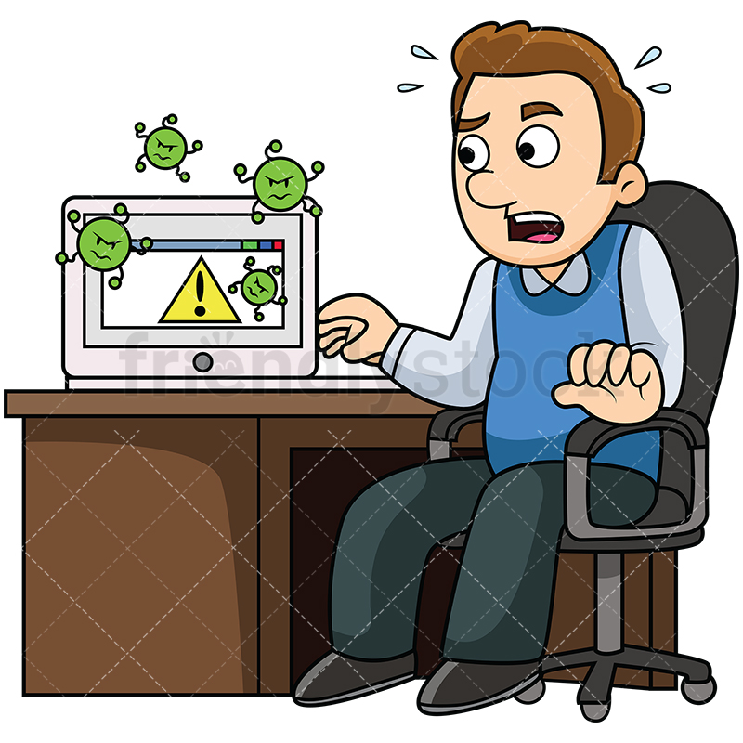

And other types of cyber crime :
And other types of cyber crime :
(i) Hacking
(ii) Virus dissemination
(iii) Logic bombs
(iv)Denial of service attack
(v) Phishing

Slide 9
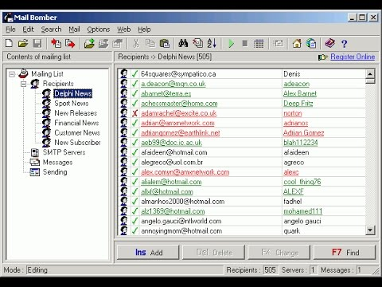
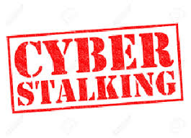
(vi) Email bombing and sparming
(vii)Web jacking
(viii) Cyber stalking
(ix) Identity theft and credit card farud
(x) Software piracy

Slide 10
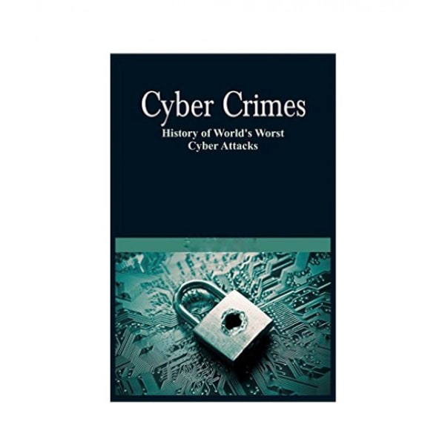
HISTORY OF CYBER CRIME :
The first recorded cyber crime took place in 1820.
In India, Japan and China, the era of modern computer,
however, began with the analytical engine of
Charles Babbage.

Slide 11
HISTORY OF CYBER CRIME :
The first spam email took place in 1976 when it was sent out over the ARPANT .
The first virus was installed on an Apple computer in 1982 when a high school student, Rich skrenta, developed the EIK Cloner.
And the last history of cyber crime is Hacked American election in 2016.

Slide 12
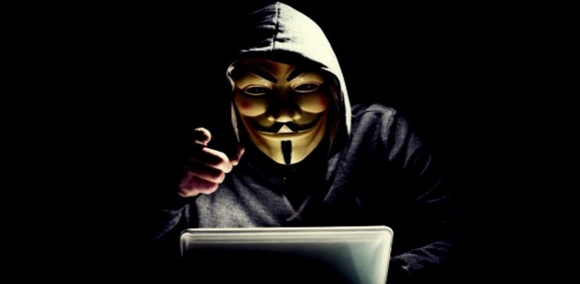
CYBER CRIMINAL :
There are four major types of cyber criminal :
(i) Kids:
Age(9-16 etc.)
(ii) The hacker cycle :
“ANONYMOUS”

Slide 13
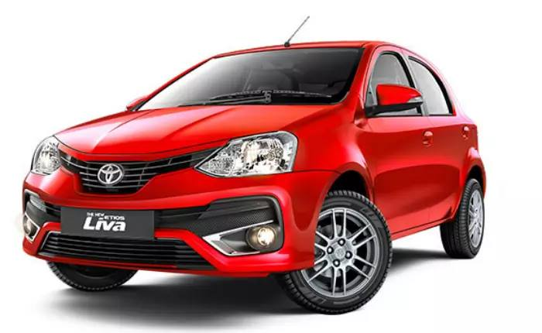
CYBER CRIMINAL
(iii) Disgruntled employees :Who is an computer engineer and angry over the company’s chief
(iv) Professional hackers :
2.KEVIN POULSEN: Hack radio station for 15 minutes and won a red wheele car

Slide 14
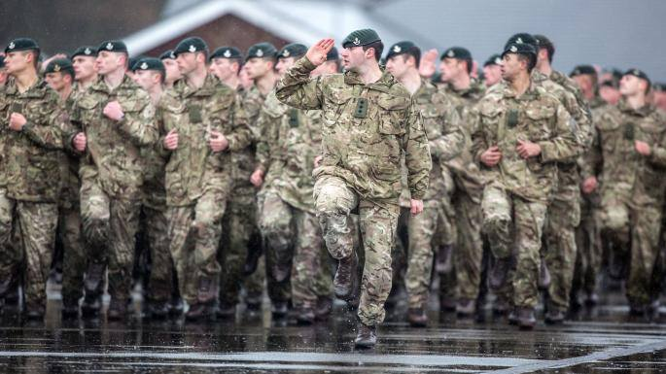

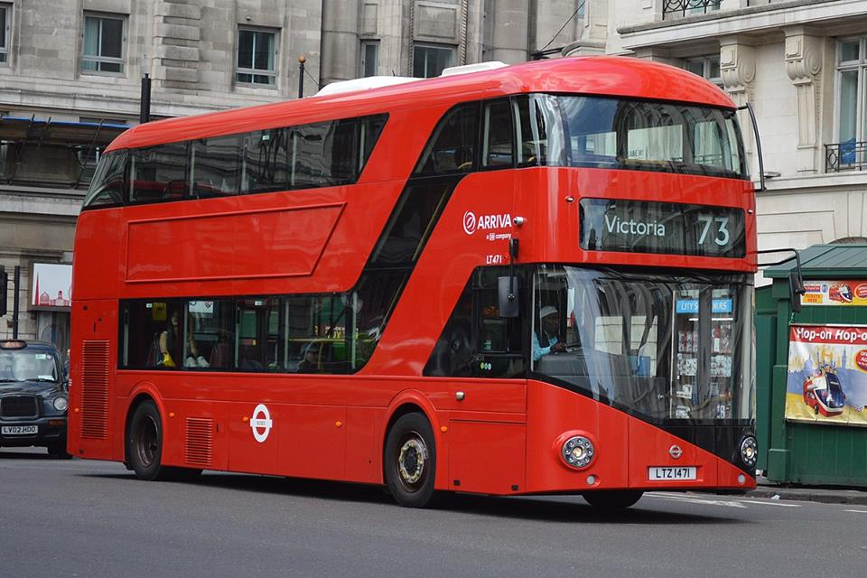
3.GARY MEKINNON : US army server
4.ADRIAN LAMO : New York Times & Microsoft
5. KEVIN MITNICK : Free bus ticket & Nokia

Slide 15
PREVENT OF CYBER CRIME :
Apps and institutions
Users

Slide 16
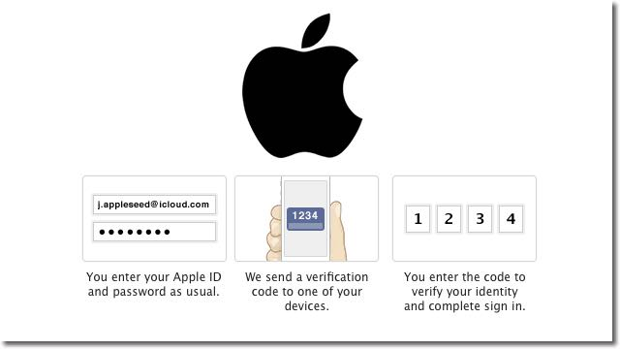
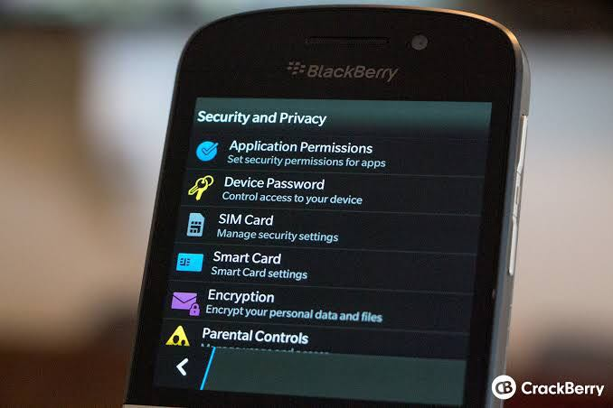
Apps and institutions
Security : Authentication, Maintain Backup.
Device : Secure device, Secure network system

Slide 17


Users :
(i) Privacy : Don’t share any information, Set a strong password.
(ii) Try to be safe by yourself : Protect your data Updating, Checking, Learn about internet privacy .

Slide 18
Conclusion :
(i) present and future of cyber crime
(ii) Impact

Slide 19
THANK YOU

